Slide 1
Building Automated Business Workflows
Turning data collection into an experience.
Online Forms and Custom Integration into your business process.
https://zalmellctraining.wordpress.com/

Slide 2
Zach Lewis – ZALME LLC
Experienced Professional – 30+yrs, IBM, Bell Labs, HP/HPE/MicroFocus, Nationwide Insurance, SAIC, Unisys, and more.
Knowledge Management/Decision Support
Tech Consulting/Training – one one one and groups.
Business Marketing/Process Transformation
Facebook Developer Circle Lead
Cyber Security Consultant
And More – Web Development, Software Development, System Design, etc..

Slide 3
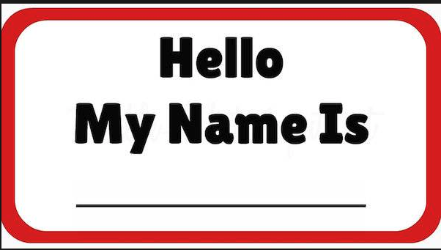

Tell us About Your Self
What is your Name
What Business or Organization do you work with ?
Why did you come ?
What do you expect to learn ?
What was your first computer ?
What is your favorite food ?

Slide 4








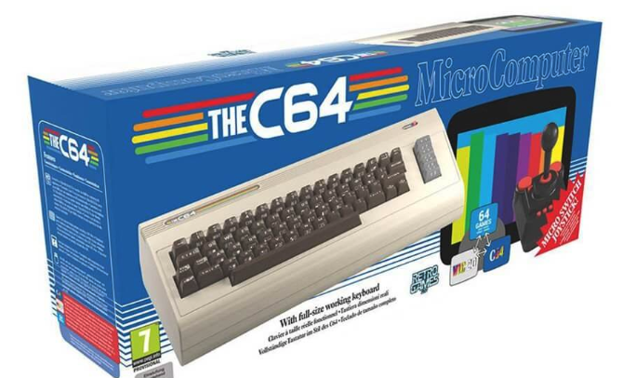



















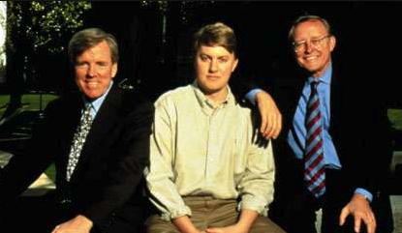



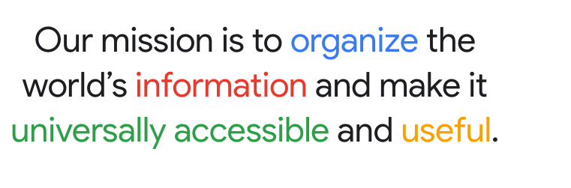
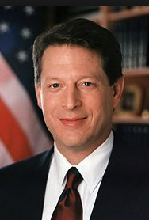




The internet changed the World ! Too Much Information
Marc Andreessen
Robert Martin McCool
James H. Clark
James Love Barksdale
Al Gore – Sponsored Bill

Slide 5
We have more Information then we can respond to everyday.
This includes your customers and business partners.

Slide 6
Potential Benefits Automating Action and Response
Speed up Response Time
Support more customers
Integrate into an existing system or business process
Share Selected information with external partners
Enhance Collaboration by providing only the information needed to various roles in a business process. Reduce information overload.

Slide 7

Question: How many of you like to wait for a response to a request or proposal ?
Still Waiting

Slide 8
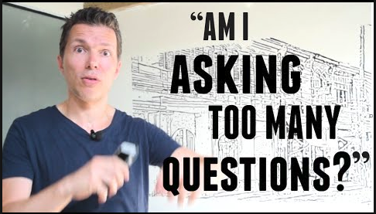
Question: How many times have you had to ask too many follow-up question for a business process or request for information ?

Slide 9


Slide 10
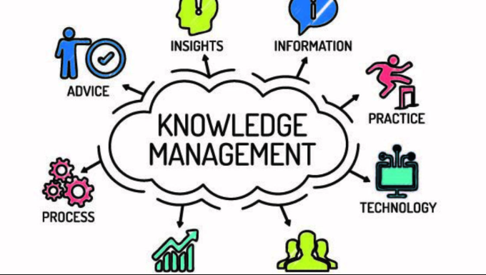
Automating Knowledge Management

Slide 11

Automated Survey/Text Response System
Decision Support and Business Workflow Support System
Input:
Automated
Comprehension
and
Response
System
Business
Process
and
Workflow
Question
Proposal
Survey
Intelligent Text
Comprehension
System
Business Process
Rules

Slide 12

Information is not Knowledge
Data is not valuable by itself.
You must understand it and apply it in a productive way.
Automating the process of understanding and acting on the information received is the Goal

Slide 13
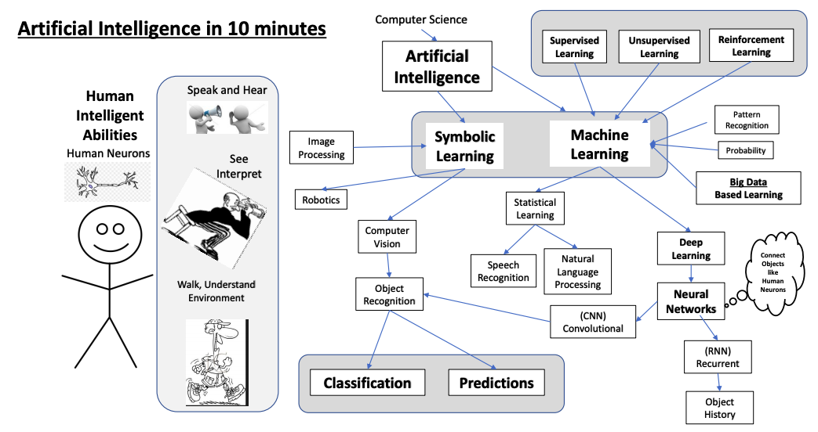

Slide 14
Information is not Valuable, The Application of Information Matters Why is Google, Amazon and Facebook So Valuable ? Why have companies that make a physical product become less valuable ?
What do they Make ?
What is the materials that they use to build their products ?
Do they need any physical items, like Wood, Steel, Hammers, Nails, etc ???

Slide 15
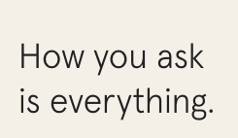



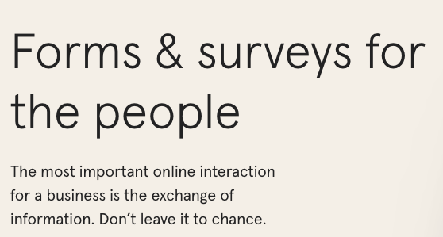





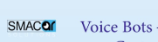
Intelligent Surveys Can Make A Difference
Typeform.com
Many Options: - We will focus on TypeForm.
https://www.google.com/forms
https://www.typeform.com

Slide 16
What data collect and you collect matters .
Think about your goal.
Flawed data can guide even the greatest leaders to the wrong conclusions.
When success hangs in the balance, you need to be absolutely sure that you're gathering the right data with the right methods.

Slide 17







What about Security?
You need to know what is required !

Slide 18
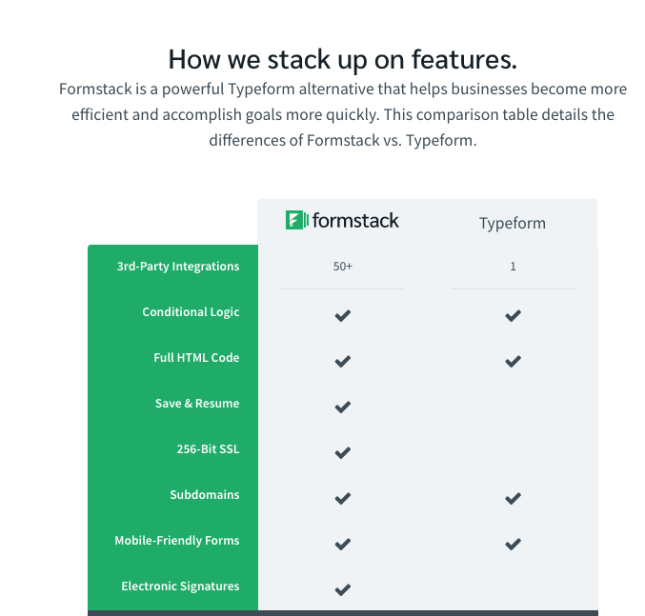
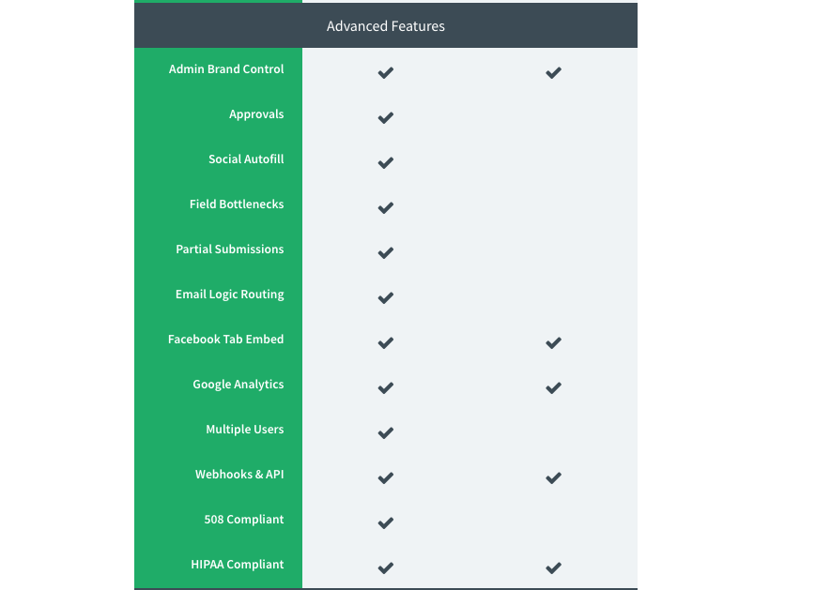
What about Security?
How do I ensure my data is Protected ?

Slide 19
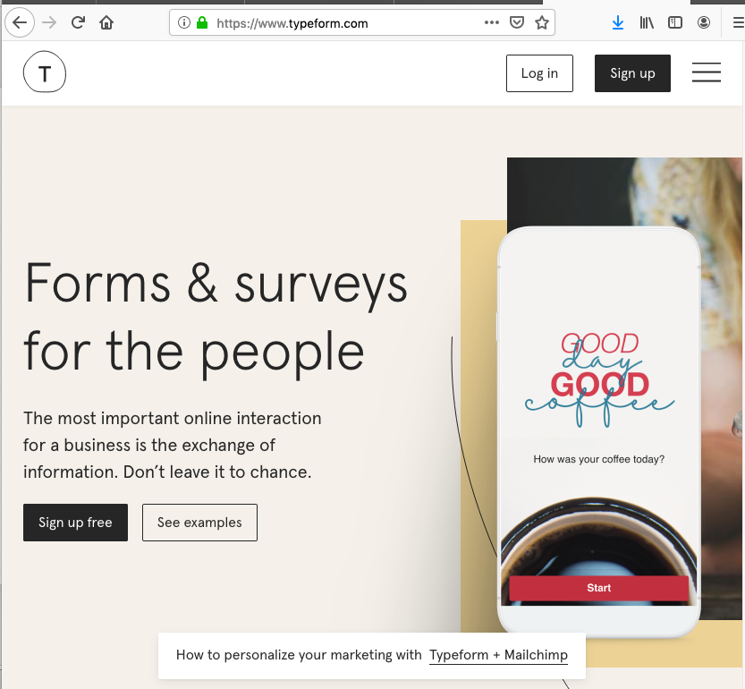

Slide 20
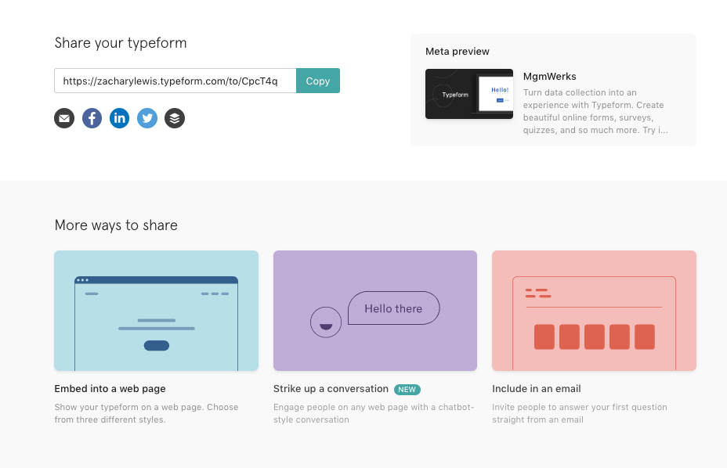
Typeform Simple Sharing Options

Slide 21
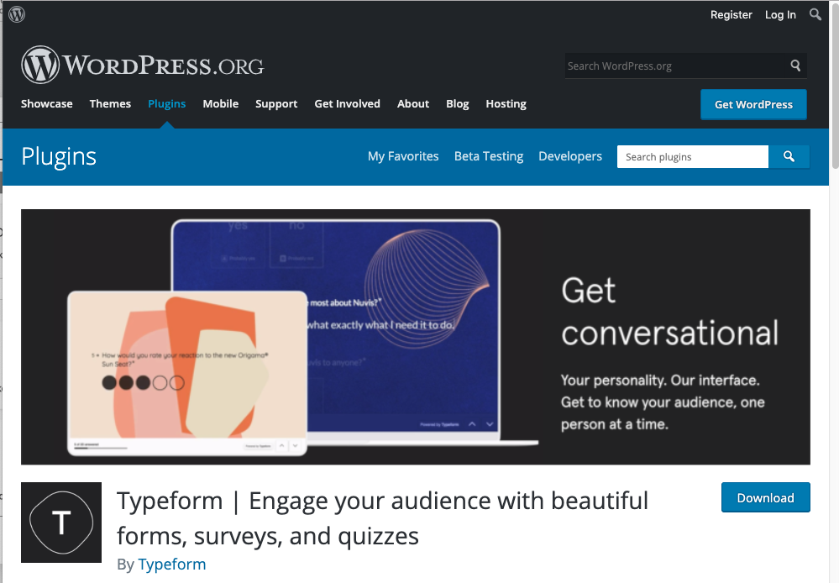
WordPress Plugin

Slide 22
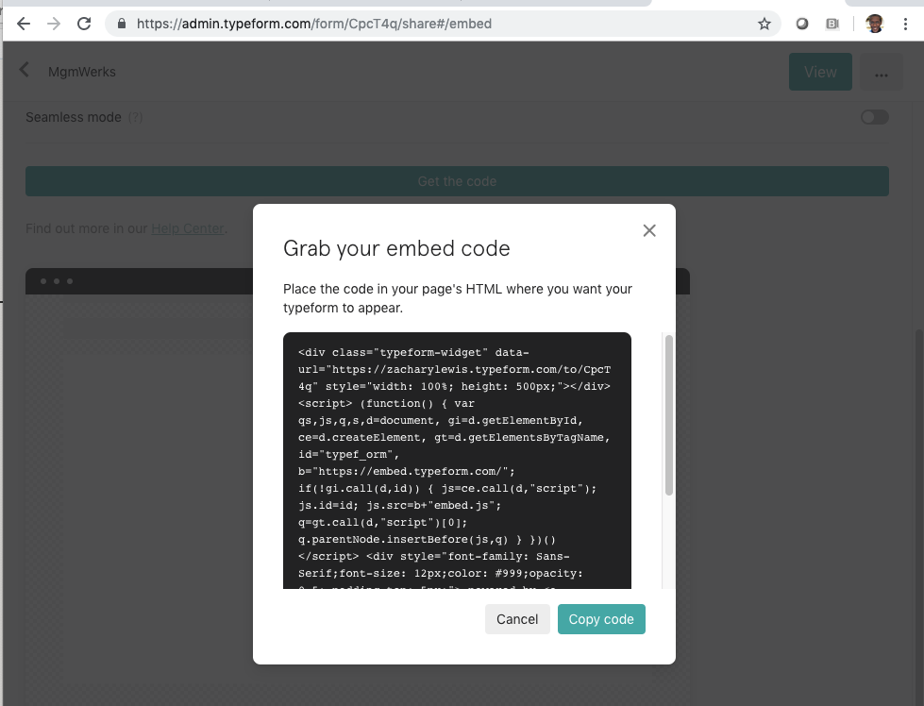
TypeForm Copy Embed HTML

Slide 23
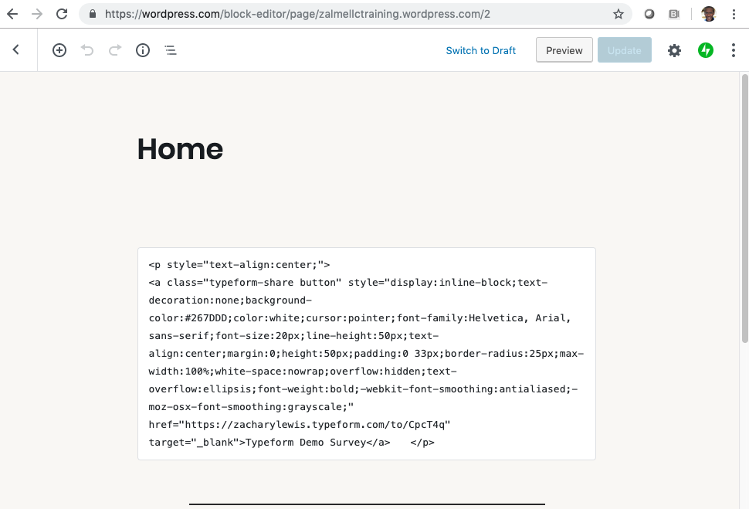
WordPress Embed HTML

Slide 24
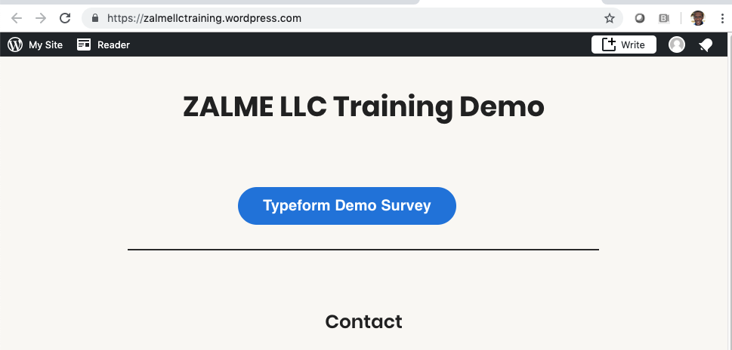
WordPress Webpage Button from Embedded HTML

Slide 25
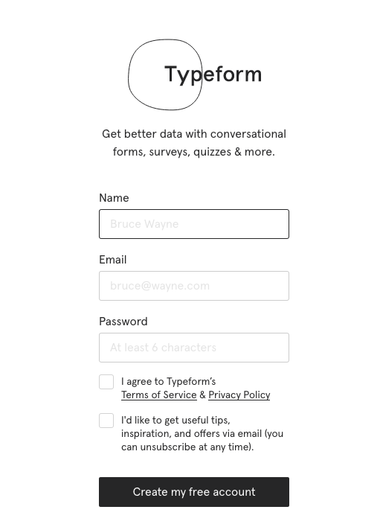
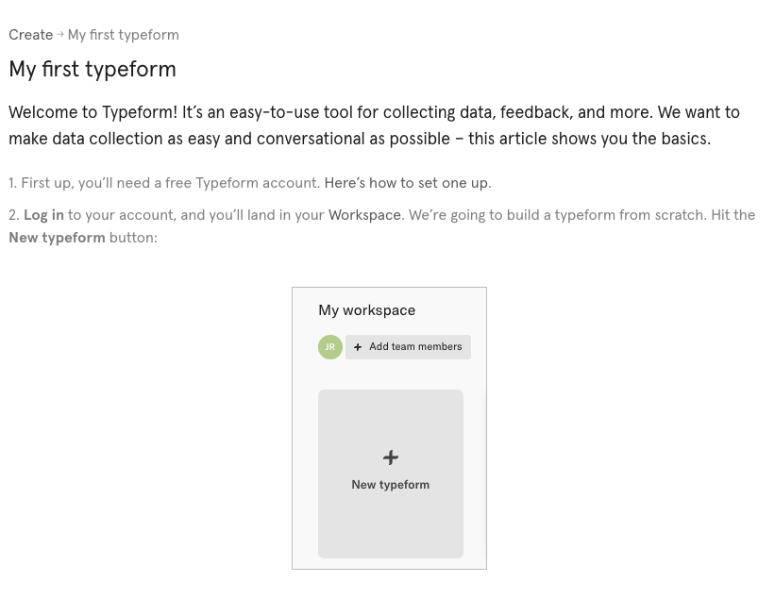

Slide 26
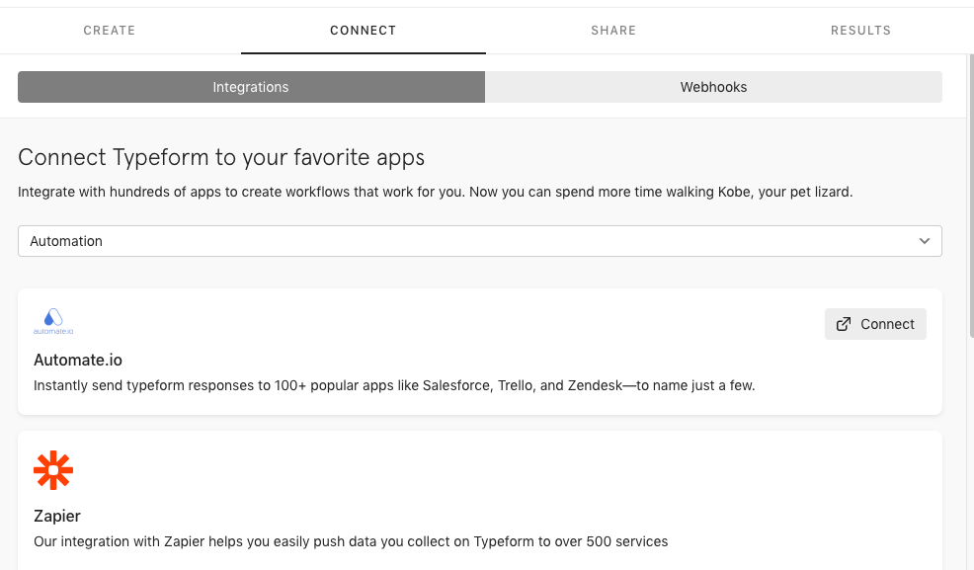

Slide 27
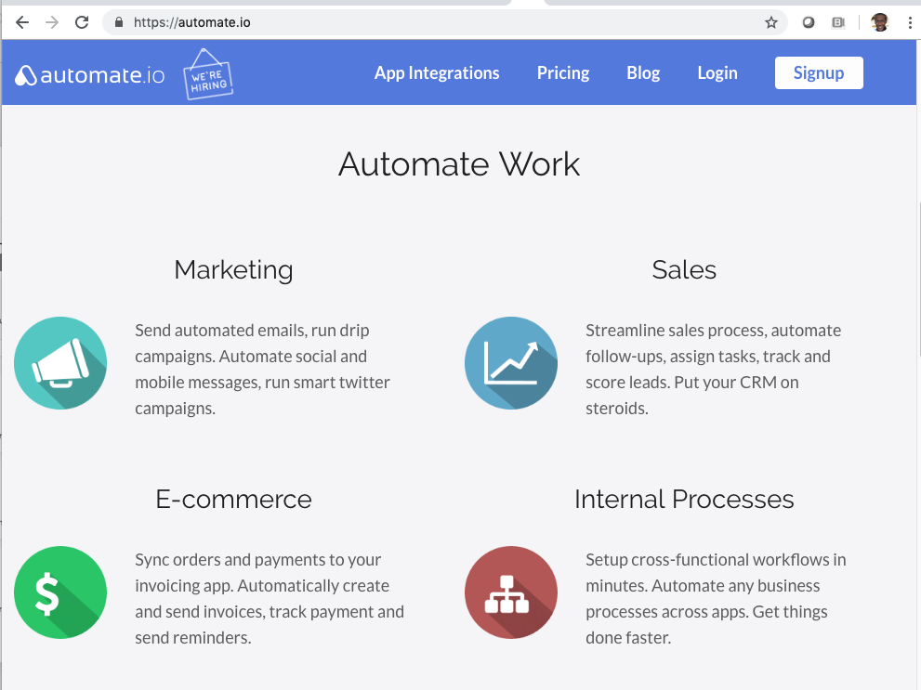

Slide 28
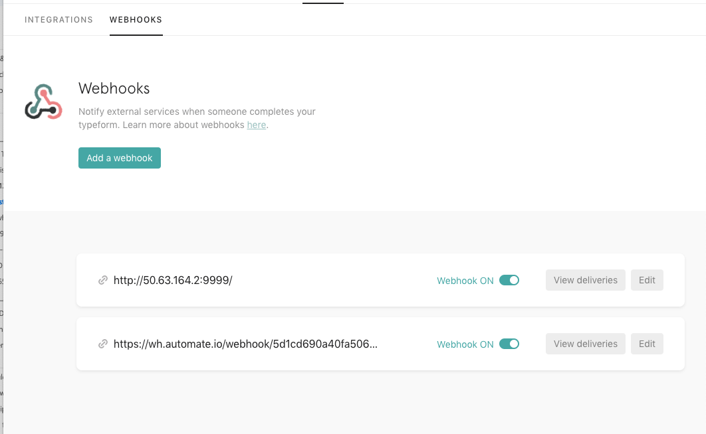
TypeForm My WebHooks Demo

Slide 29
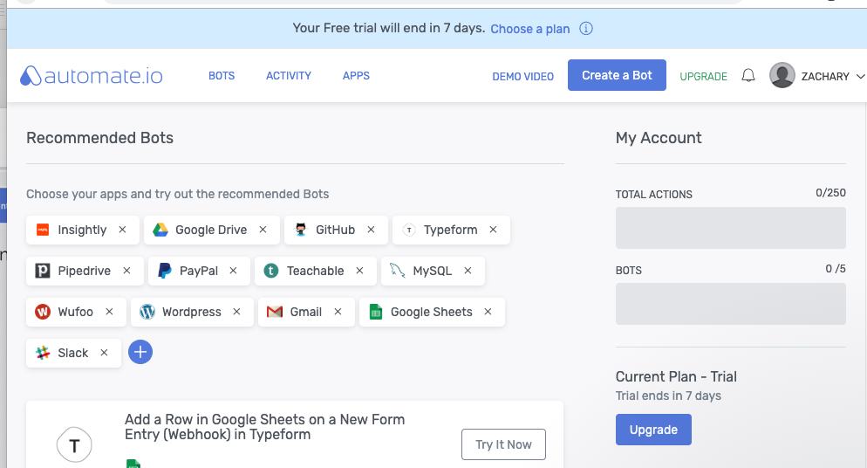
TypeForm My WebHooks Automate.io Demo

Slide 30
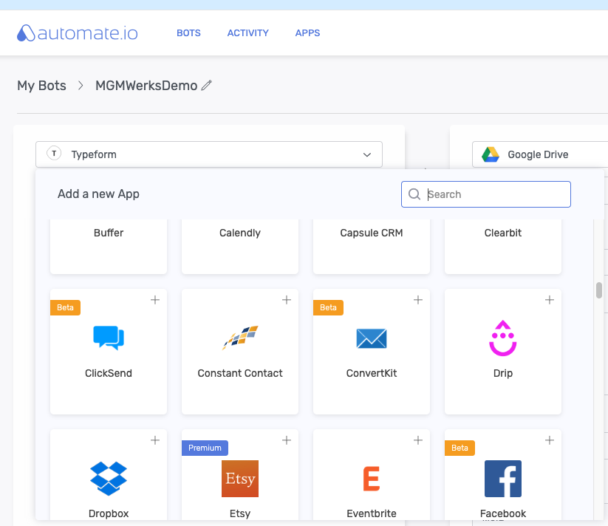
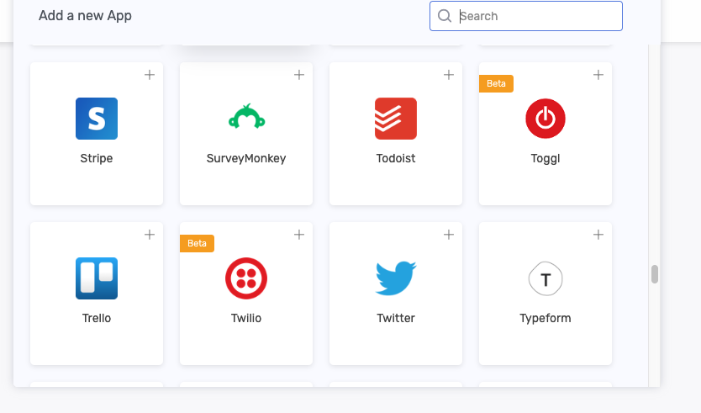
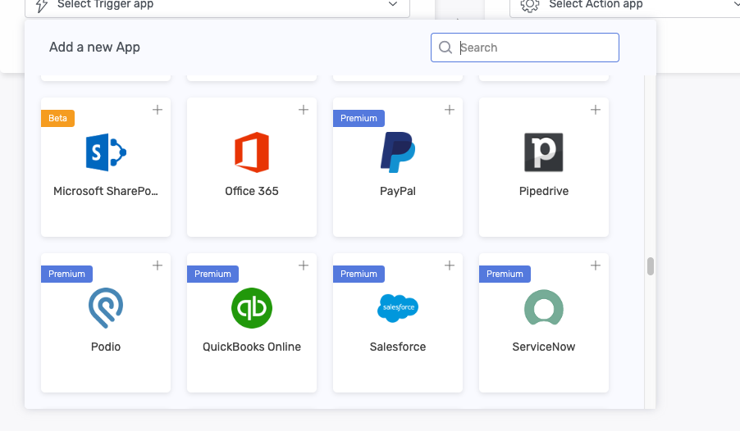
Yes you can integrate with many other products.

Slide 31
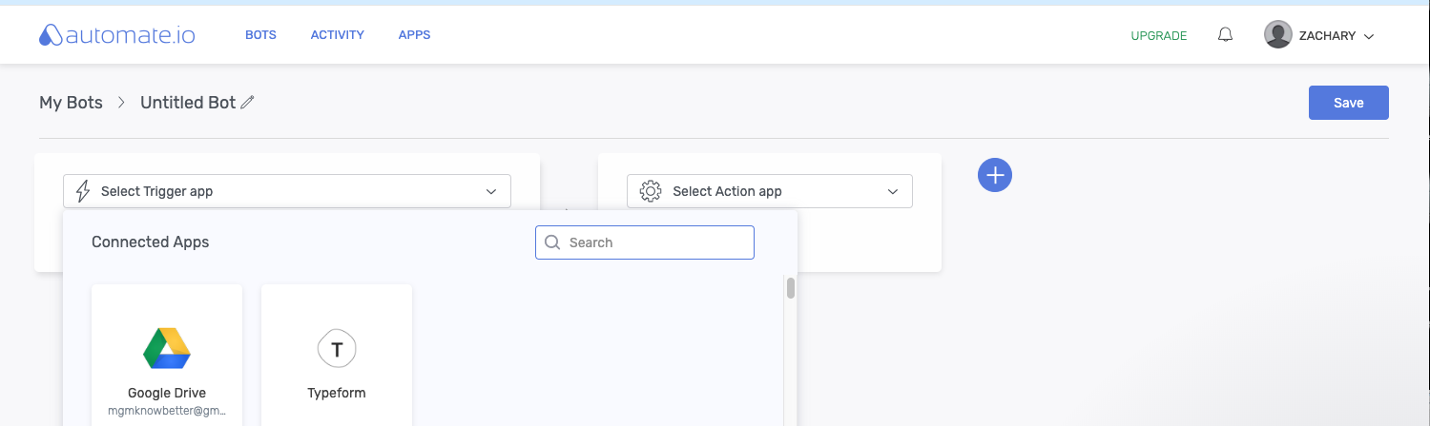
Automate.IO
Create a Automated Bot in 5 minutes

Slide 32
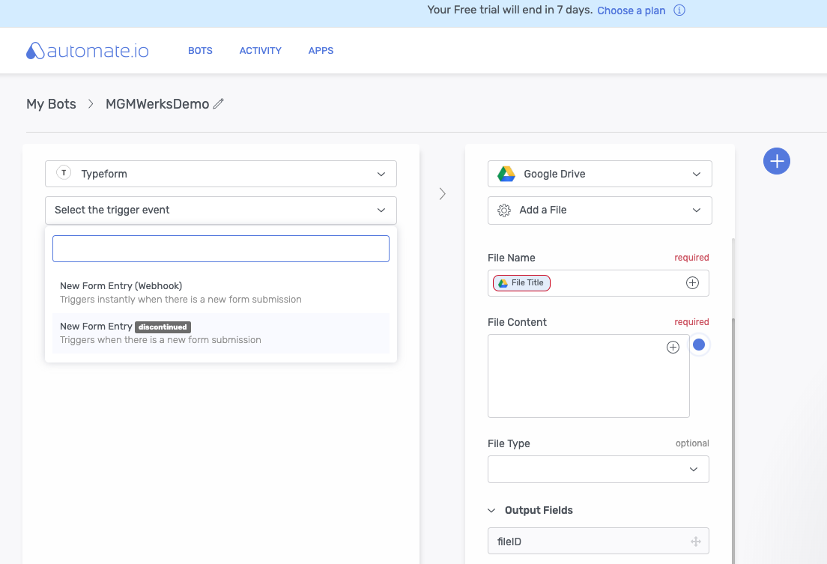
Create a Automated Bot in 5 minutes

Slide 33
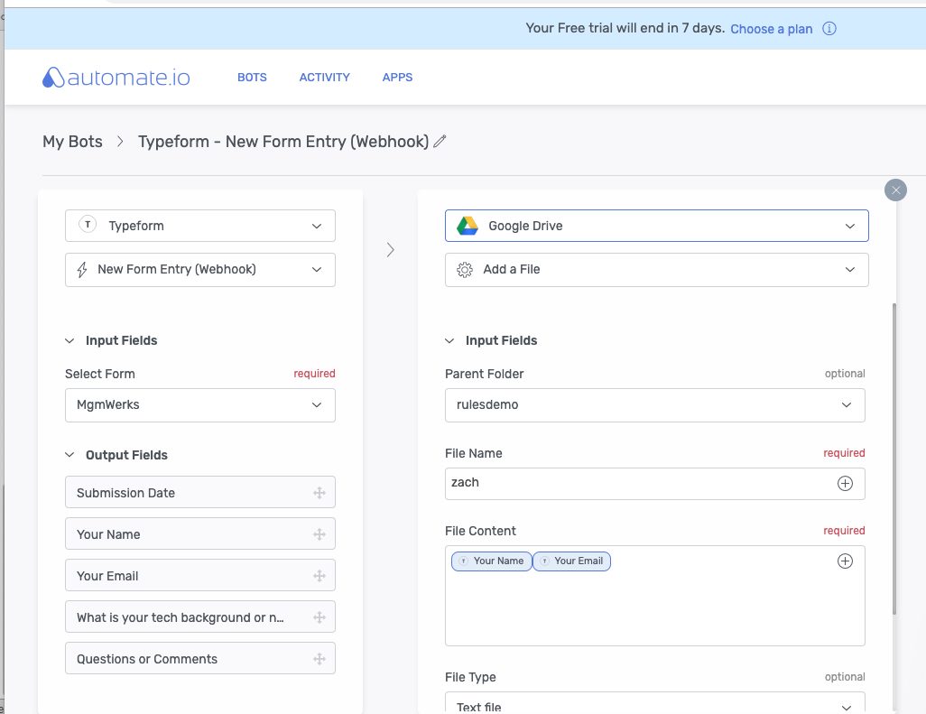

Slide 34
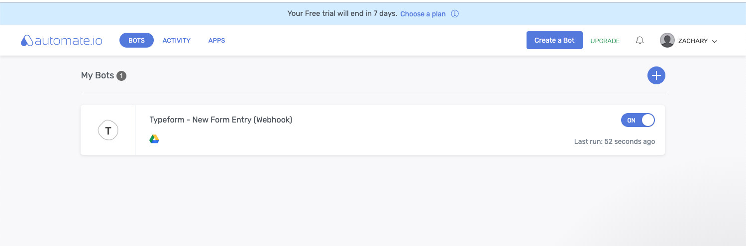

Slide 35
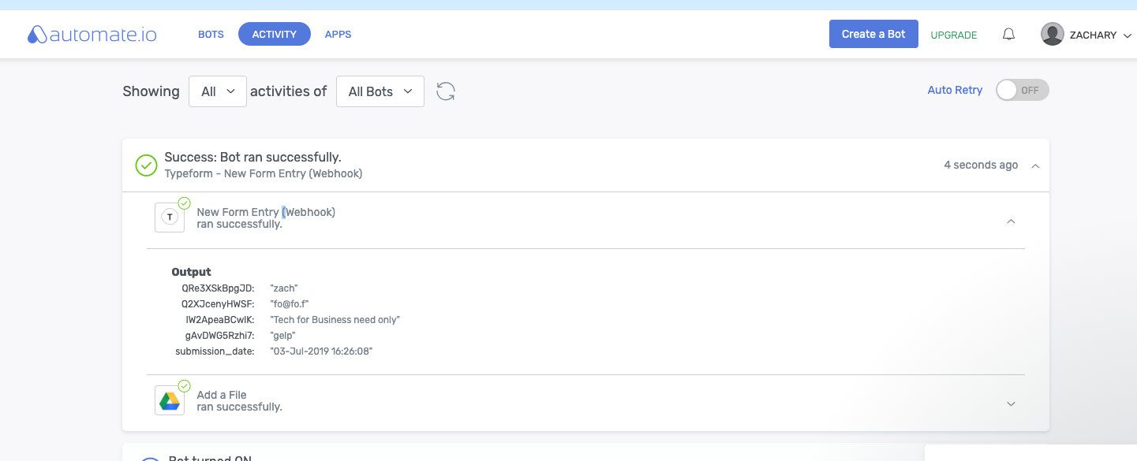

Slide 36
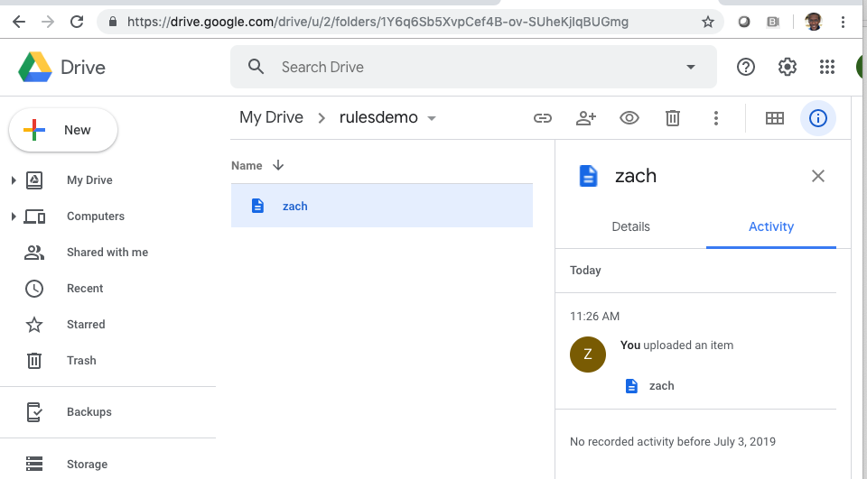

Slide 37
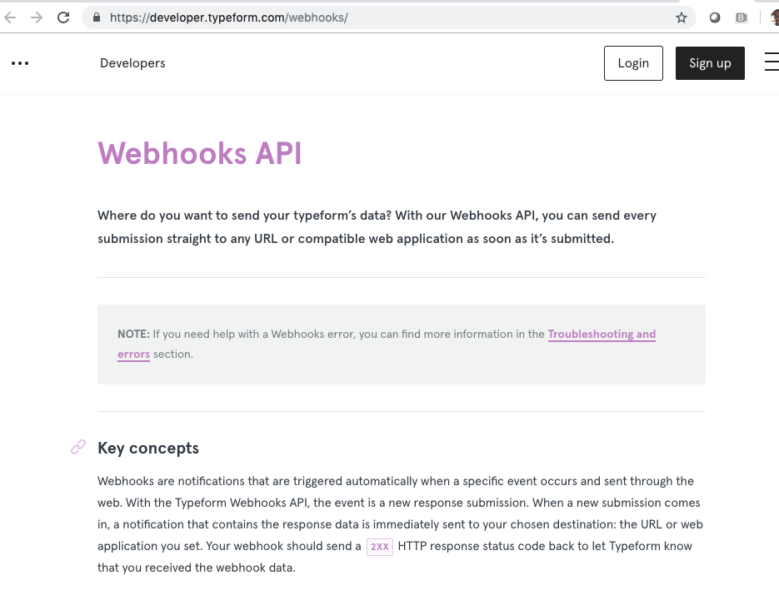
You can build your own custom Bot and use your own Website.

Slide 38
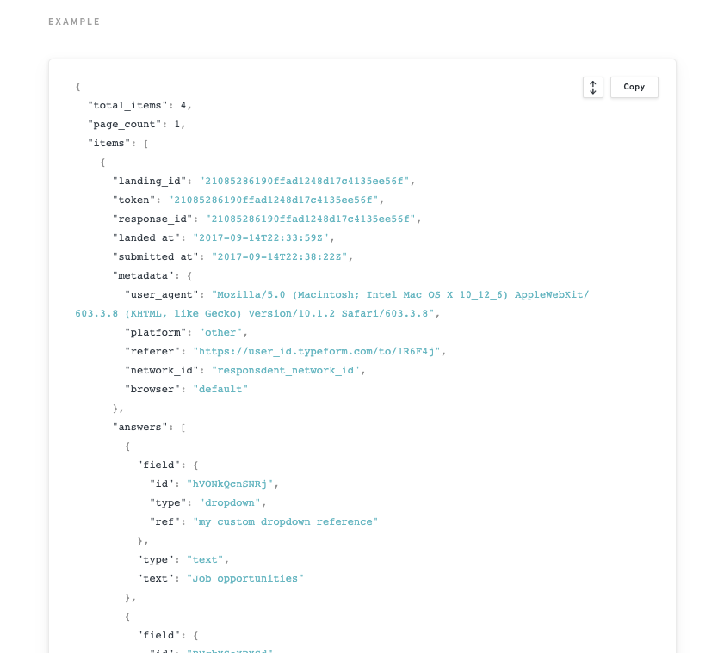

Typeform webhooks
Return JSON

Slide 39


Slide 40
TypeForm My WebHooks Python Demo
My Host with a simple JSON processor

Slide 41
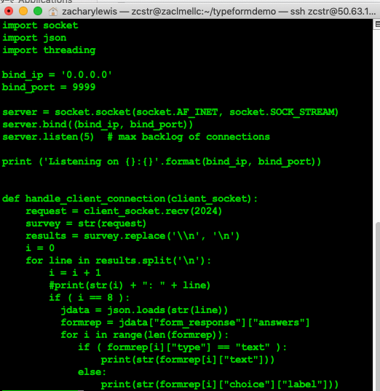
My Simple Typeform Python Json Processor

Slide 42
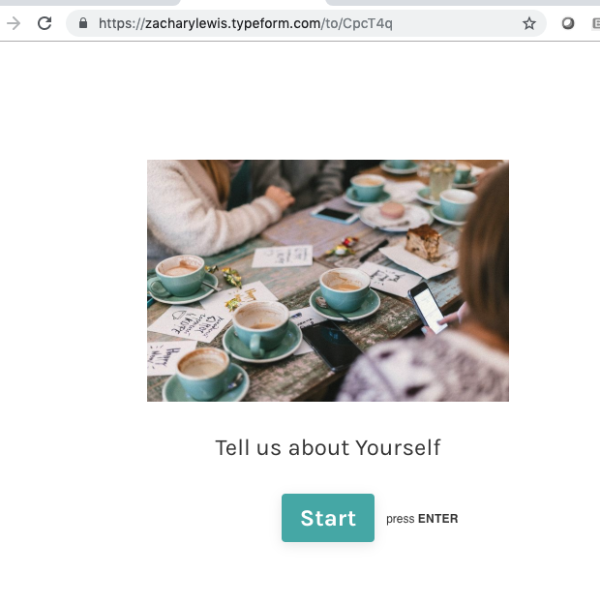
TypeForm My WebHooks Python Demo

Slide 43
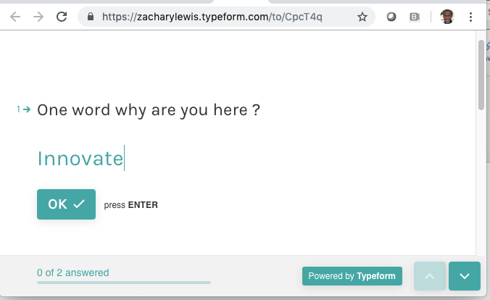

Slide 44
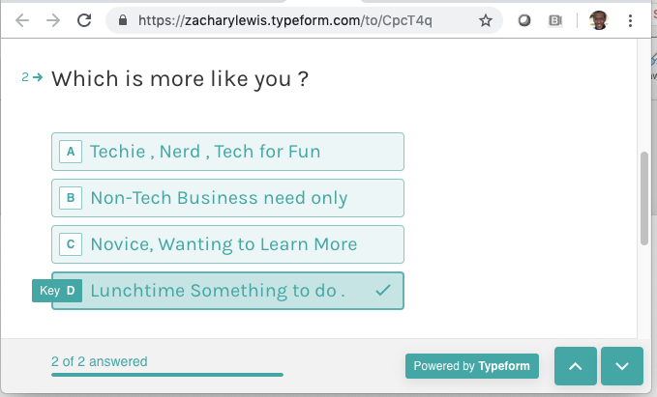

Slide 45
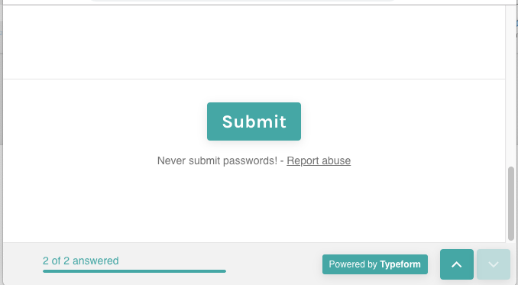

Slide 46
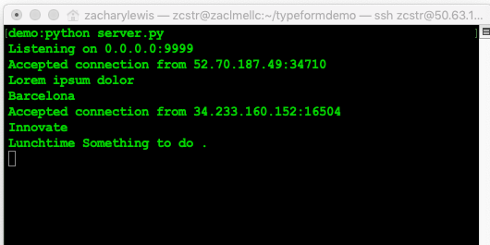
TypeForm My WebHooks Python Demo

Slide 47
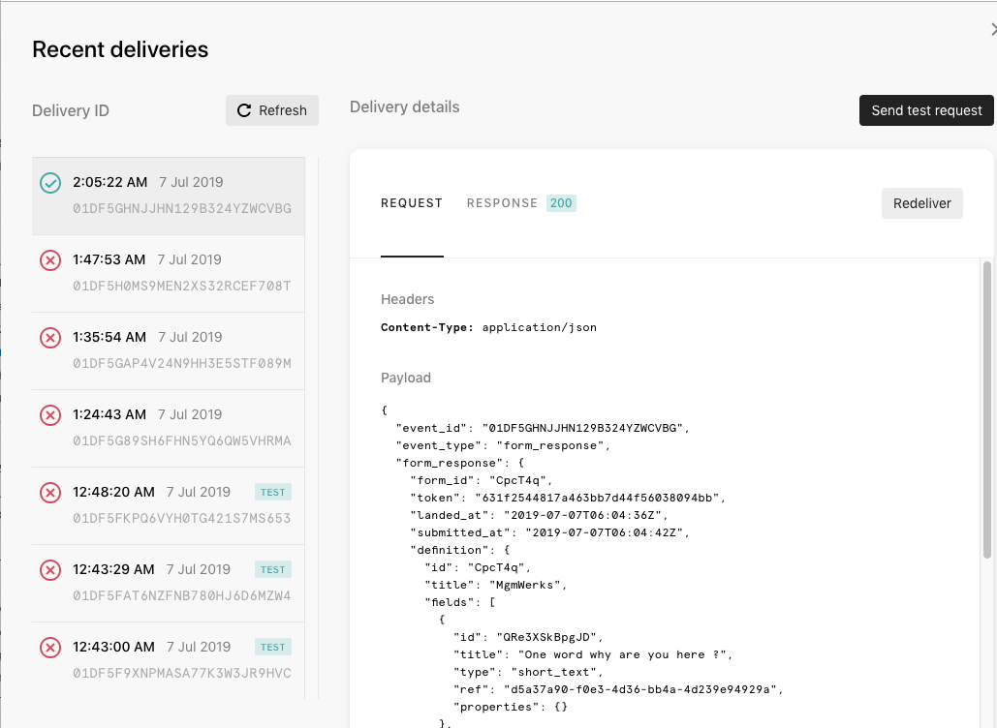
TypeForm My WebHooks Request are stored and can be Resent
If server is down Demo

Slide 48
Automating Knowledge Management

Slide 49
Potential Benefits Automating Action and Response
Speed up Response Time
Support more customers
Integrate into an existing system or business process
Share Selected information with external partners
Enhance Collaboration by providing only the information needed to various roles in a business process. Reduce information overload.

Slide 50
Questions ??

